Slide 1


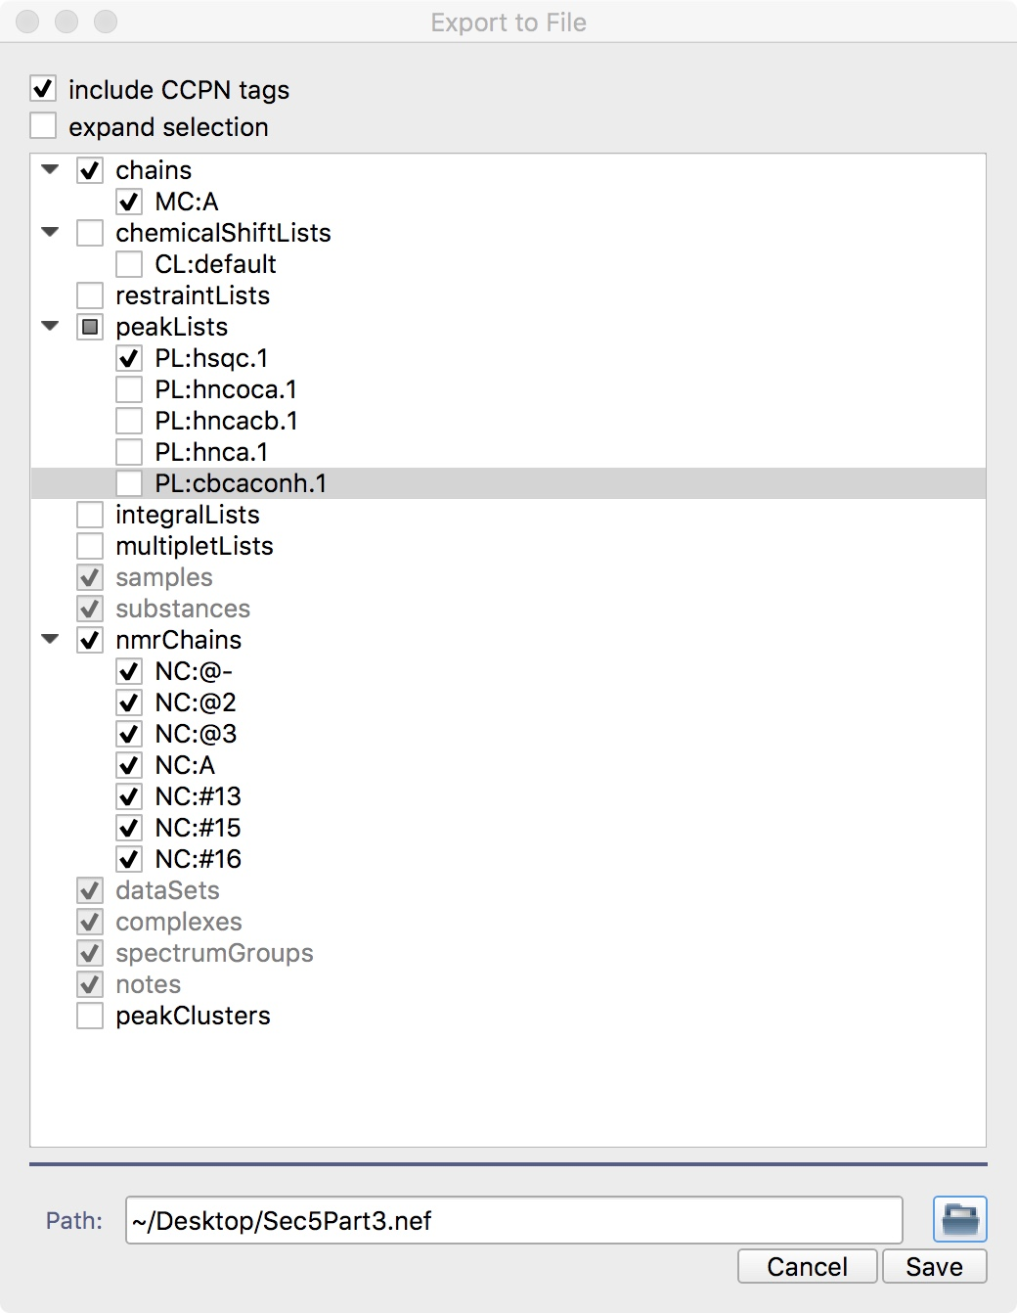
CcpNmr Analysis Version 3
How To’s:
Use NEF to
import and export CcpNmr data

Slide 2

Introduction
This How-To will guide through a simple action of using the NMR Exchange Format, NEF, to import and export data from one CcpNmr project to another. This is only a practical example and not the main purpose of NEF, for documentation and other usages please visit:
https://github.com/NMRExchangeFormat/NEF.
In this tutorial you will export the hsqc peak list contained in the project Sec5part3 and import in Sec5Part1 just using a NEF file.
You can use this mechanism to import/export any data from/to any CcpNmr projects, however, use this with extremely caution in order to avoid name clashes or unwanted merging which could cause a data loss.
Start CcpNmr Analysis V3
Apple users by double clicking the icon CcpNmrAnalysis
Linux users by using the terminal command: bin/assign

Slide 3
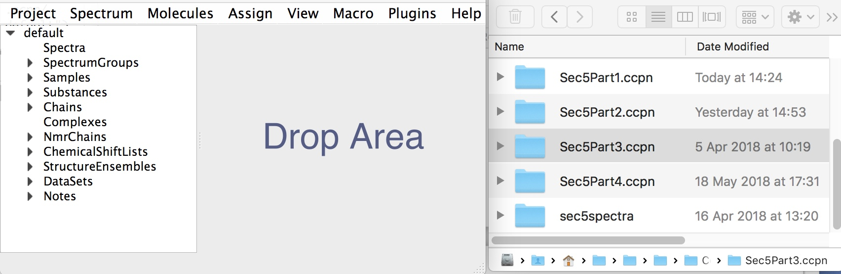
How To
1
Export to NEF
Sec5Part3
Open Sec5Part3
shortcut E,X
1A
Open the project containing the peak list you need to export
Open the project Sec5Part3
Open the NEF export popup: Main Menu: Project → NEF → Export Nef File (shortcut E,X)
The exporter window will appear, expand all branches

Slide 4
How To
1
Export to NEF
Sec5Part3
1B
Select exporting options
Select:
chains: MC:A
peakLists: PL:hsqc.1
nmrChains: all options
Deselect:
ChemicalShiftLists, restraintList, integralLists, multipletLists, peakClusters
Click on the folder icon, select a path where to save the Nef.
Click Save

Slide 5
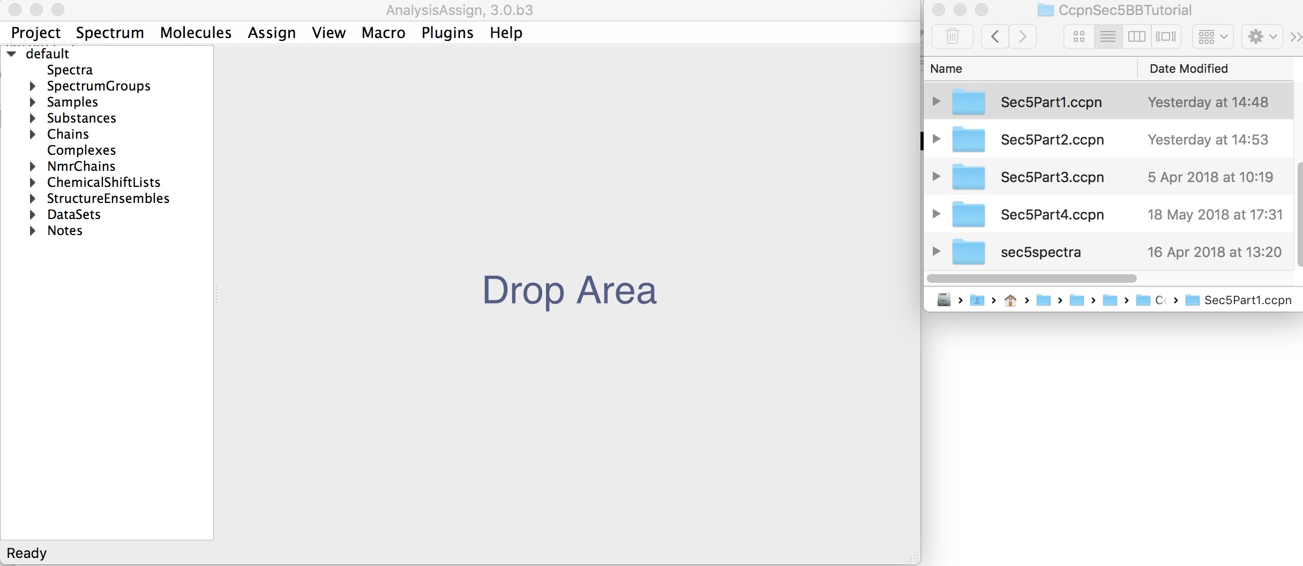
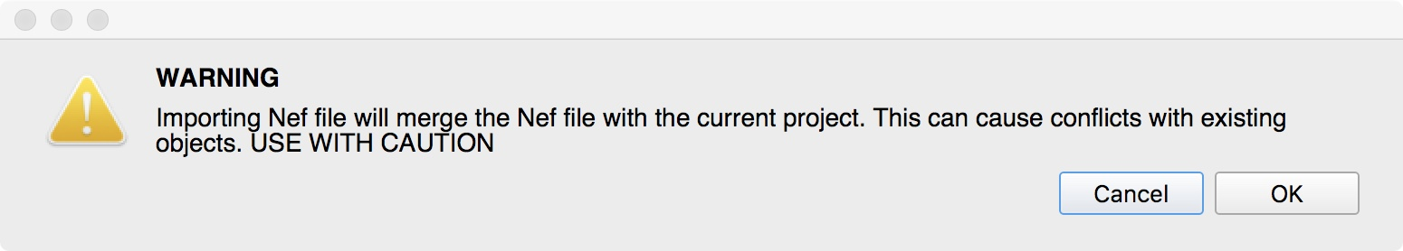
How To
1
Import from NEF
Sec5Part1
Run a new CcpNmr Analysis instance
Open Sec5Part1
shortcut I,N
1C
Import on a target project: Sec5Part1
Run a new CcpNmr Analysis instance
Open the project Sec5Part1
Open the NEF import popup: Main Menu: Project → NEF → Import Nef File (shortcut I,N)
Press Ok on the Warning popup
A new File Dialog will appear, select the previously saved NEF file
click ok to continue
The new peak list and other objects will be merged to your existing project.

Slide 6
CcpNmr Analysis Version 3
Contact Us
Website:
www.ccpn.ac.uk
Suggestions and comments:
ccpnmr3@google.com
Issues and bug report:
https://bitbucket.org/ccpnmr/issue-tracker/
Cite Us
CcpNmr AnalysisAssign: a flexible platform for integrated NMR analysis
Cite NEF
NMR Exchange Format: a unified and open standard for representation of NMR restraint data
Tutorial Version History:
beta3 (LGM): First version

